Slide 1


Group analyses
Will Penny
Wellcome Trust Centre for Neuroimaging
University College London

Slide 2
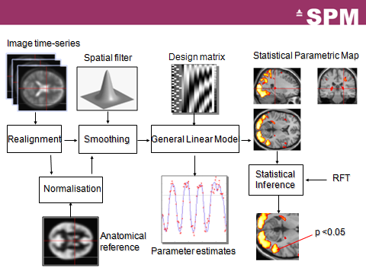

Slide 3
GROUP ANALYSIS
Fixed Effects Analysis (FFX)
Random Effects Analysis (RFX)
Multiple Conditions

Slide 4
GROUP ANALYSIS
Fixed Effects Analysis (FFX)
Random Effects Analysis (RFX)
Multiple Conditions

Slide 5
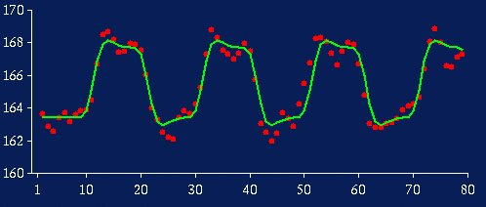
Subject 1
For voxel v in the brain
Effect size, c ~ 4
Within subject variability, s_{w}~0.9

Slide 6
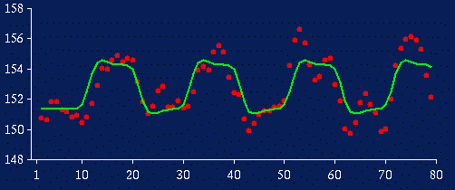
Subject 3
For voxel v in the brain
Effect size, c ~ 2
Within subject variability, s_{w}~1.5

Slide 7
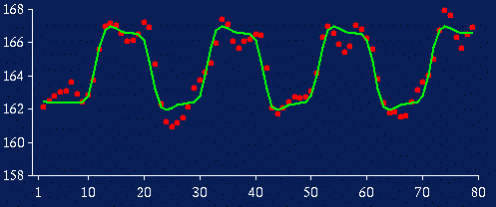
Subject 12
For voxel v in the brain
Effect size, c ~ 4
Within subject variability, s_{w}~1.1

Slide 8
Fixed Effects Analysis
Time series are effectively concatenated – as though we had one subject with N=50x12=600 scans.
s_{w} = [0.9, 1.2, 1.5, 0.5, 0.4, 0.7, 0.8, 2.1, 1.8, 0.8, 0.7, 1.1]
Mean effect, m=2.67
Average within subject variability (stand dev), s_{w} =1.04
Standard Error Mean (SEM_{W}) = s_{w} /sqrt(N)=0.04
Is effect significant at voxel v?
t=m/SEM_{W}=62.7
p=10⁻⁵¹

Slide 9
GROUP ANALYSIS
Fixed Effects Analysis (FFX)
Random Effects Analysis (RFX)
Multiple Conditions

Slide 10
Subject 1
For voxel v in the brain
Effect size, c ~ 4

Slide 11
Subject 3
For voxel v in the brain
Effect size, c ~ 2

Slide 12
Subject 12
For voxel v in the brain
Effect size, c ~ 4

Slide 13
Whole Group
For group of N=12 subjects effect sizes are
c = [4, 3, 2, 1, 1, 2, 3, 3, 3, 2, 4, 4]
Group effect (mean), m=2.67
Between subject variability (stand dev), s_{b} =1.07
Standard Error Mean (SEM) = s_{b} /sqrt(N)=0.31
Is effect significant at voxel v?
t=m/SEM=8.61
p=10⁻⁶

Slide 14
Random Effects Analysis (RFX)
For group of N=12 subjects effect sizes are
c= [3, 4, 2, 1, 1, 2, 3, 3, 3, 2, 4, 4]
Group effect (mean), m=2.67
Between subject variability (stand dev), s_{b} =1.07
This is called a Random Effects Analysis because we are comparing the group effect to the between-subject variability.

Slide 15
Summary Statistic Approach
For group of N=12 subjects effect sizes are
c = [3, 4, 2, 1, 1, 2, 3, 3, 3, 2, 4, 4]
Group effect (mean), m=2.67
Between subject variability (stand dev), s_{b} =1.07
This is also known as a summary statistic approach because we are summarising the response of each subject by a single summary statistic – their effect size.

Slide 16
RFX versus FFX
With Fixed Effects Analysis (FFX) we compare the group effect to the (average) within-subject variability. It is not an inference about the sample from which the subjects were drawn.
With Random Effects Analysis (RFX) we compare the group effect to the between-subject variability. It is an inference about the sample from which the subjects were drawn. If you had a new subject from that population, you could be confident they would also show the effect.

Slide 17
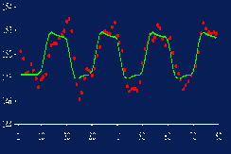
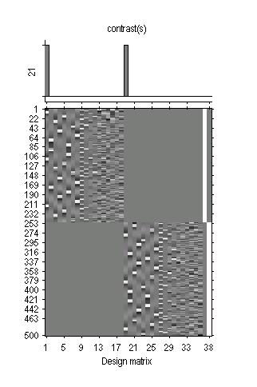
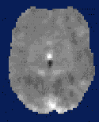
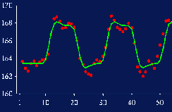
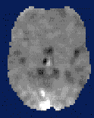

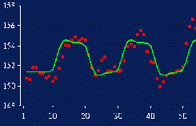
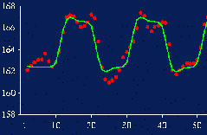
RFX: Summary Statistic
First level
Data Design Matrix Contrast Images

Slide 18
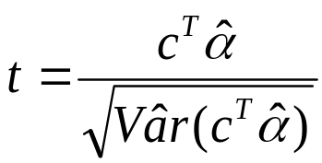
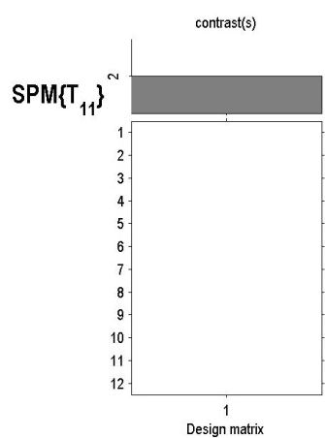
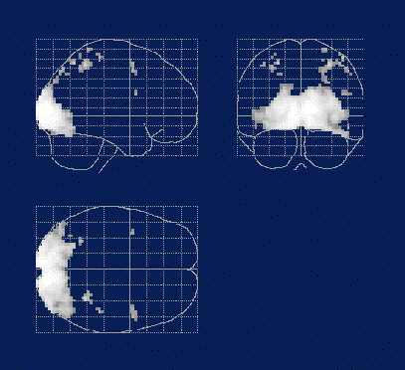

RFX: Summary Statistic
First level
Second level
Data Design Matrix Contrast Images
SPM(t)
One-sample
t-test @ 2nd level

Slide 19
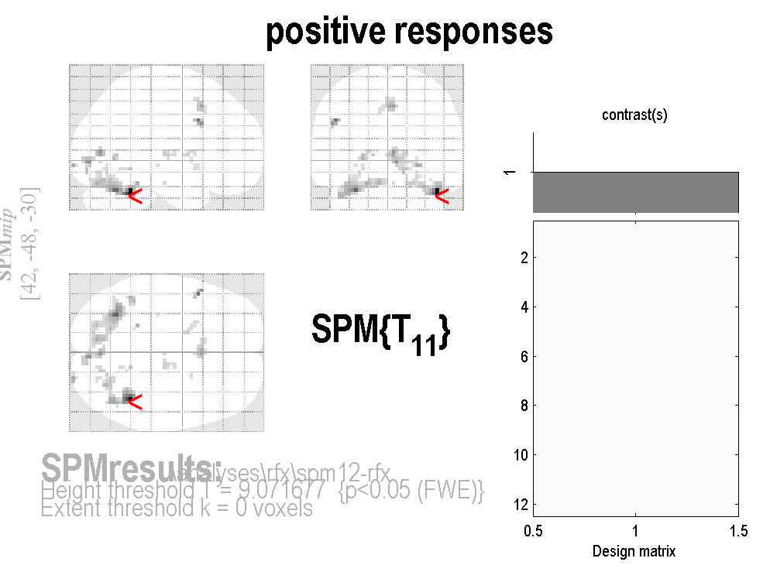
Face data

Slide 20
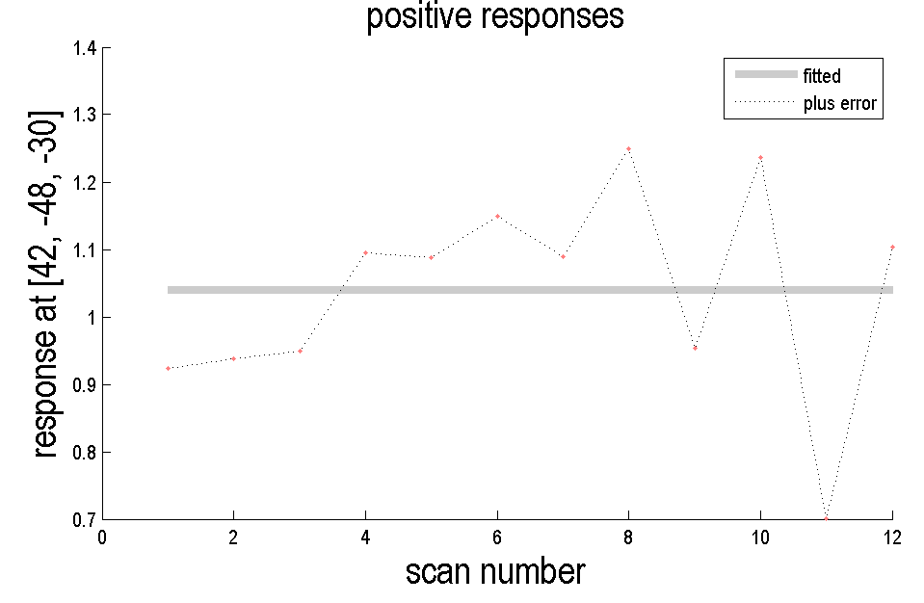
Face data

Slide 21
GROUP ANALYSIS
Fixed Effects Analysis (FFX)
Random Effects Analysis (RFX)
Multiple Conditions

Slide 22
ANOVA
Condition 1 Condition 2 Condition3
Sub1 Sub13 Sub25
Sub2 Sub14 Sub26
... ... ...
Sub12 Sub24 Sub36
ANOVA at second level (eg clinical populations). If you have two conditions this is a two-sample t-test.

Slide 23
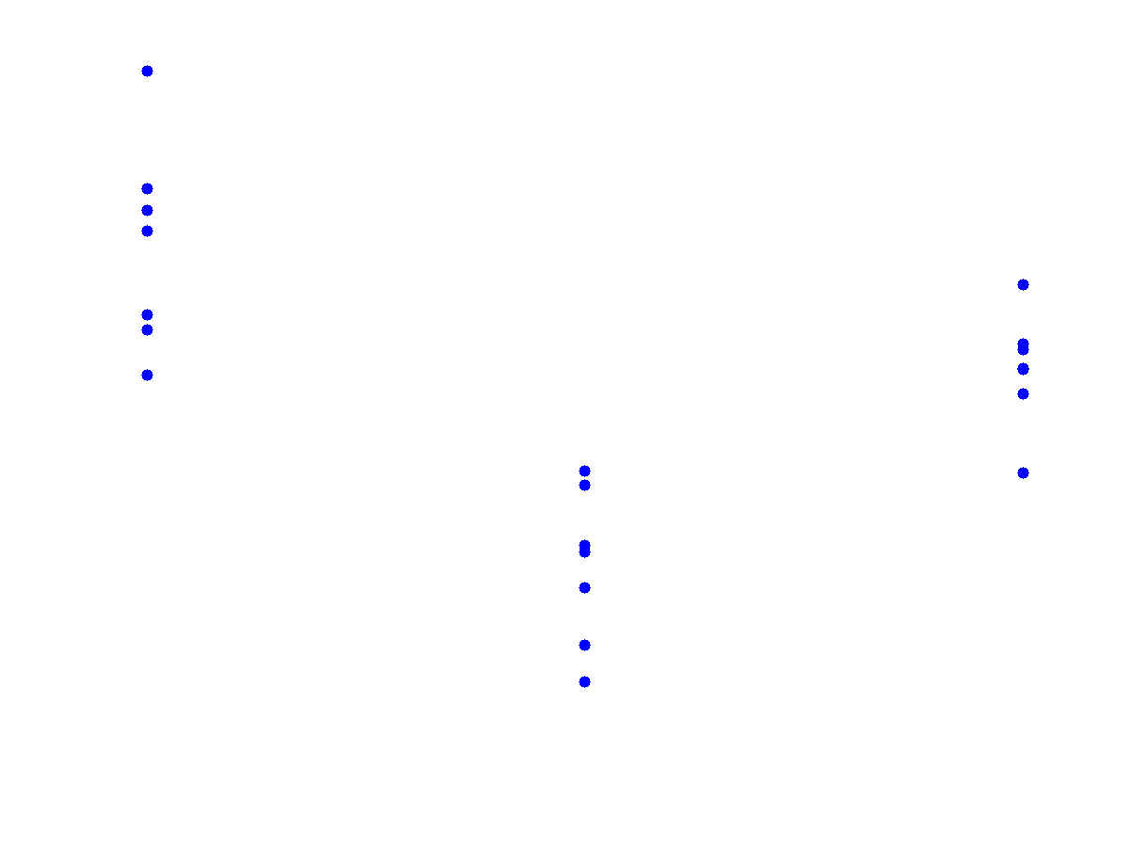
Condition 1
Condition 2
Condition 3
Response
Each dot is a different subject

Slide 24
ANOVA within subject
Condition 1 Condition 2 Condition3
Sub1 Sub1 Sub1
Sub2 Sub2 Sub2
... ... ...
Sub12 Sub12 Sub12
ANOVA within subjects at second level (eg same subjects on placebo, drug1, drug2).
This is an ANOVA but with subject effects removed. If you have two conditions this is a paired t-test.

Slide 25
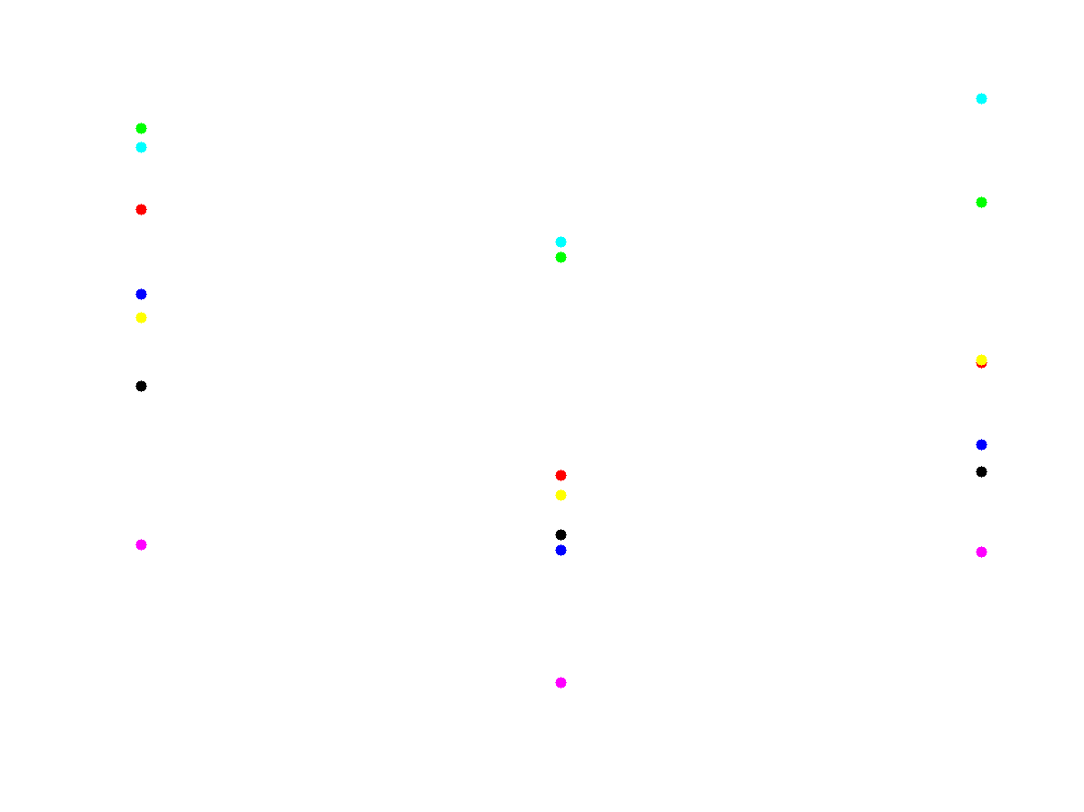
Condition 1
Condition 2
Condition 3
Response
Each colour is a different subject

Slide 26
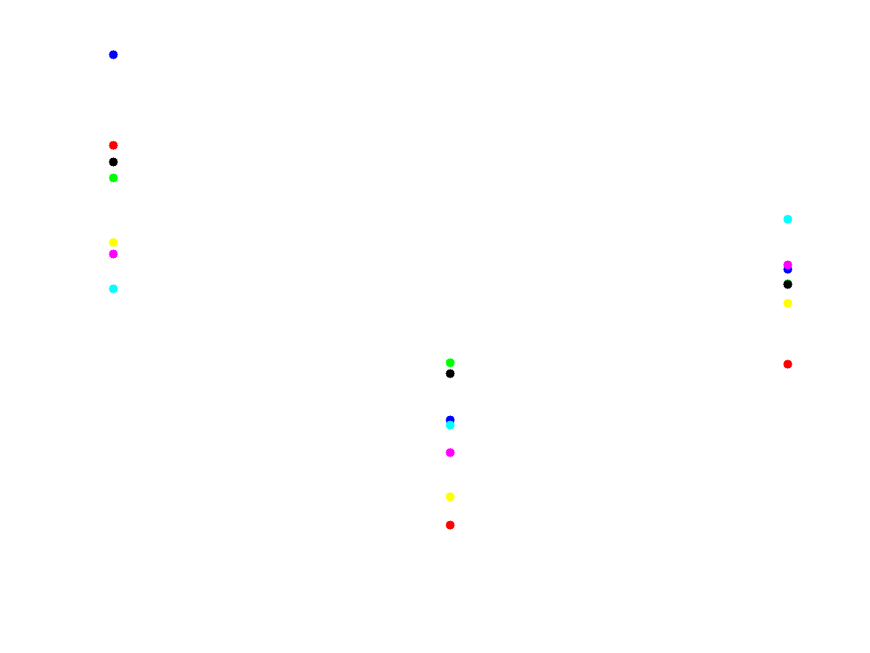
Condition 1
Condition 2
Condition 3
Response
With subject effects (means) subtracted, the difference in conditions is more apparent

Slide 27
Summary
Group Inference usually proceeds with RFX analysis, not FFX. Group effects are compared to between rather than within subject variability.
Can also use ANOVA at second level for inference about multiple experimental conditions..
W. Penny and A. Holmes. Random effects analysis. In Statistical Parametric Mapping: The analysis of functional brain images. Elsevier, London, 2006
J Mumford and T Nichols. Simple Group fMRI Modelling and Inference. Neuroimage, 47(4):1469-75, 2009.

